Slide 1
Neural Network Implementation of a Large Dataset
ANN model of 1D-cooling Process
(-by Saurabh Kumar, 16d100018)

Slide 2
Problem Statement
Can we make a data-driven model for cooling process??
Attempted to build a 1D-cooling process model, with fixed maintained boundary temperatures at the two ends.

Slide 3
Methodology
Looked forward for a framework, which when given values(input) of state at a given instant could give us(output) those state values at the next time step or after some time-interval Δt in general, without explicitly using the physics involved in the process.
As suggested by literature and professor Shyamprasad Karagadde, Artificial Neural Network is one of the many ways to achieve the objective.

Slide 4
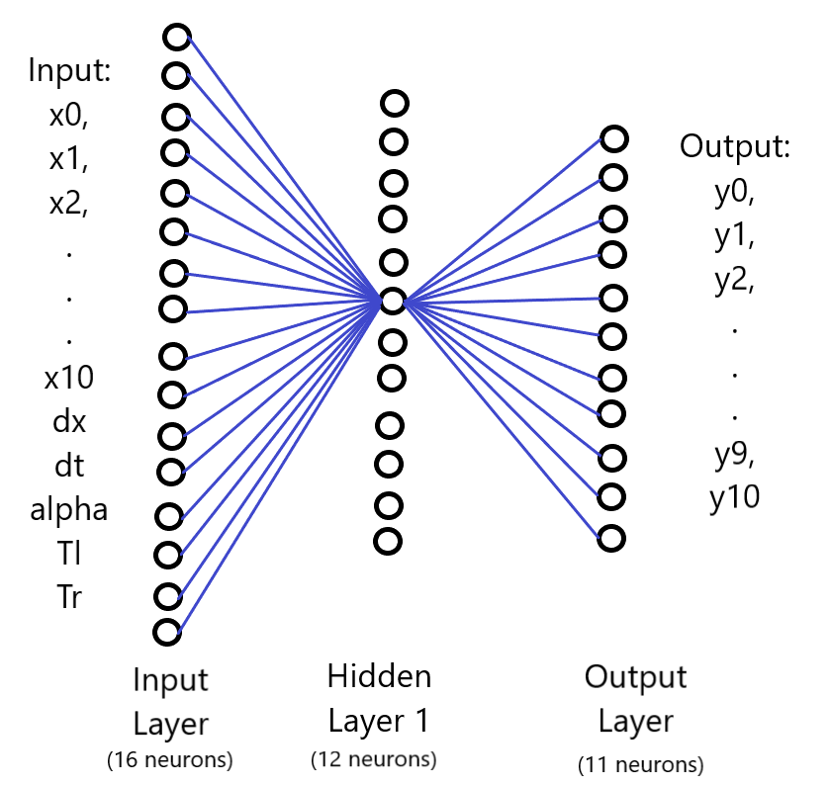
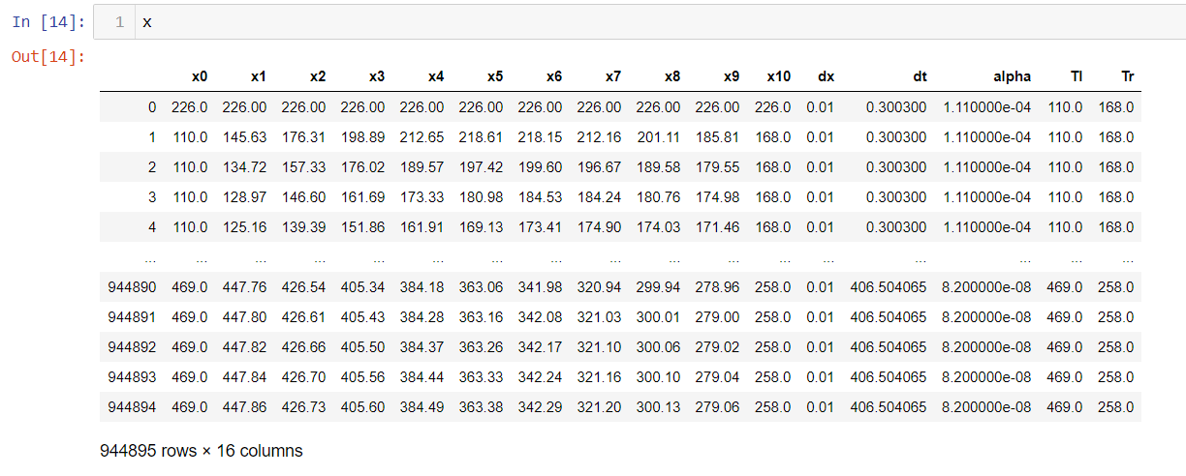
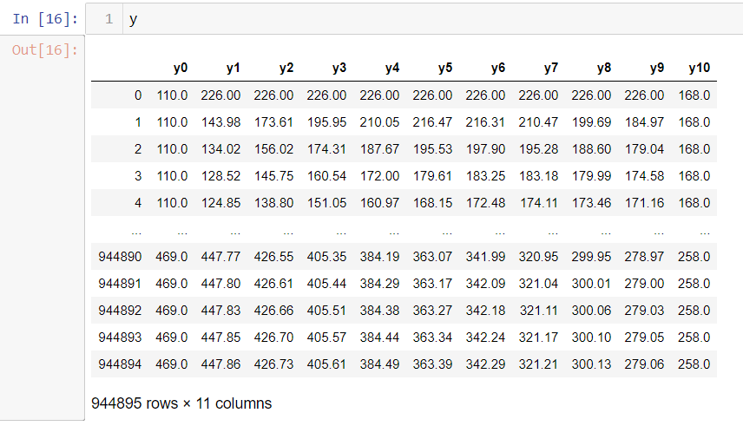
Implementation(Model Framework)
Fig1: Model representing optimised number of neurons(local optimum)
Fig2 and Fig 3: Model Training and Testing data

Slide 5
Model Hyperparameters tuning
File Name | Parameters Space | Selected Parameters
ANN_model_1D-cooling_stage2_Optimisation1 | 'hidden_layer_sizes': [(12,10), (10,10,10)], 'activation': ['relu', 'tanh'] | 'hidden_layer_sizes': (12, 10), 'activation': 'relu'
ANN_model_1D-cooling_stage2_Optimisation2 | 'hidden_layer_sizes': [(12,10), (10,10), (8,8)] | 'hidden_layer_sizes': (8, 8)
ANN_model_1D-cooling_stage2_Optimisation3 | 'hidden_layer_sizes': [(8,8), (5,5), (4,3), (8,6)] | 'hidden_layer_sizes': (8, 8)
ANN_model_1D-cooling_stage2_Optimisation4 | 'hidden_layer_sizes': [(8,8), (12)] | 'hidden_layer_sizes': 12
ANN_model_1D-cooling_stage2_Optimisation5 | 'hidden_layer_sizes': [(6), (8), (10), (11), (12)] | 'hidden_layer_sizes': 12
ANN_model_1D-cooling_stage2_Optimisation6 | 'hidden_layer_sizes': [(12), (13), (14) | 'hidden_layer_sizes': 12
The converged parameters are: 'hidden_layer_sizes': 12; 'activation': 'relu’. However, this is just a local optimum, but does a good job of predicting, approaches R2 value of ~ 1 and very low MSE as well.

Slide 6
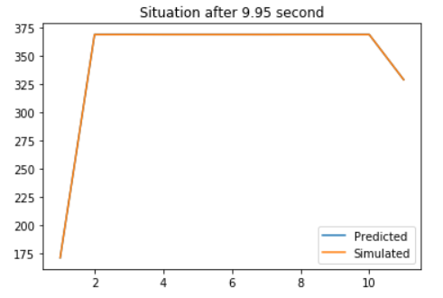
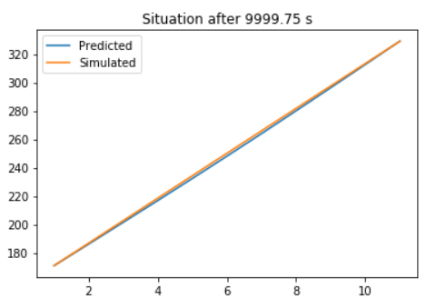
Input-Output Examples
Model Results for steel sample: 1st one represents situation after 1 unit of dt, and 2nd one represents situation after a general time interval of ~ 10000 s. The predicted curve matches very closely with simulated one.
Note: Here, as 1D-cooling process has pretty straight-forward relation, here we have model running time actually higher(roughly double) than simulation process, generally it will be other way round for complicated processes!

Slide 7
Results/Conclusions
The project demonstrates that data-driven model can be exploited to let machine learn the relations involved in the quantity that we are interested in, and can complement our understanding for the processes where we don’t have reliable relationship existing between input and output parameters.
This method can also be used for processes where the physics involved is reasonably complex, data driven predictions is generally quicker in such scenarios.
Model learning statistics
MSE: 0.004185
R2: 0.9999997

Slide 8
Steps/Instructions to run the code file(s)
ANN_model_1D-cooling_stage1 | Optimisation Attempts | ANN_model_1D-cooling_stage3_Final
Provide path to an existing folder, with a file name following it in block No. 5 and 31(ideally it should be 10 but on re-running it has been changed to 31) Eg: r'C:\Users\Saurabh\Desktop\Summer20\IITB__Courses\ComputationalTools\Project\dataset\model3\data1.csv’ model3 is an existing folder and data1 is a file name which will be populated with data once code is being run. The same file is being read in next mentioned block | A separate folder named ‘Optimisation_attempts’ is attached in the submission inside code files folder To run these files, we need to provide path of an existing dataset created in previous attempt, stage1 in block #10, or let the data creating blocks not be in markdown format, turn it back to code format. | Provide path to an existing folder in 1st block followed by a filename.csv Eg: r'C:\Users\Saurabh\Desktop\Summer20\IITB__Courses\ComputationalTools\Project\dataset\final\data2.csv’ ‘final’ is a folder already existing at the mentioned location, and we have a filename as data2, which will be created and populated with training and testing dataset. Just run the model and provide custominput parameters in code block following ‘Custom Check’ block to see how the model performs
All three stage files, can be run independently, last one is the final optimised one!!

Slide 9
Thank You

